Slide 1

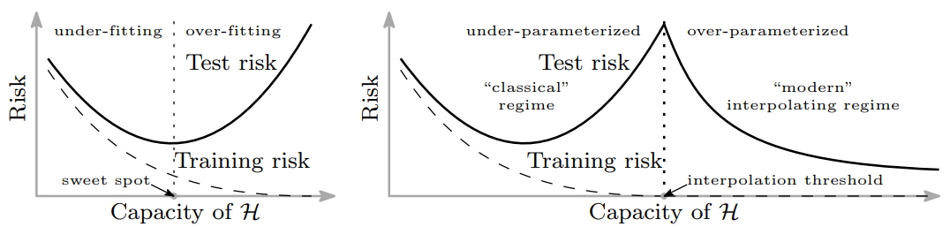


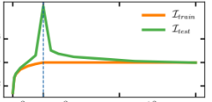
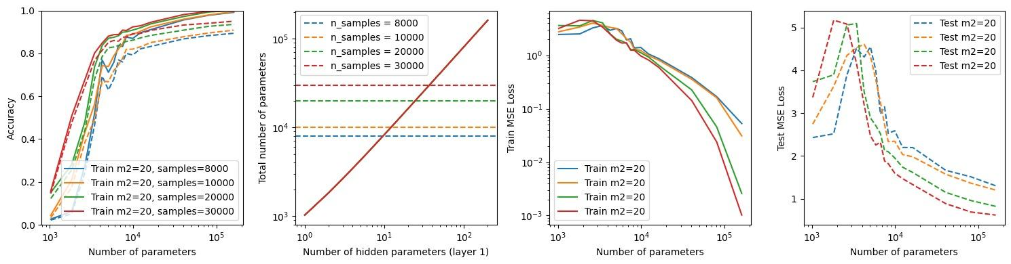
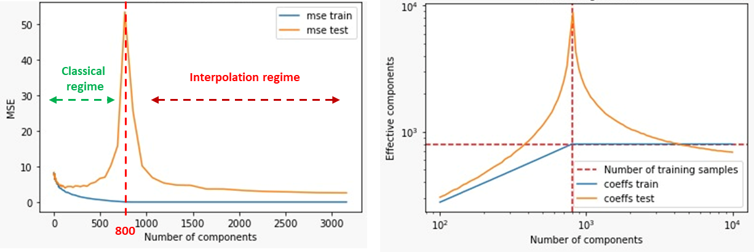
Discussion on A U-turn on double descent:
Rethinking Parameters Counting in
Statistical Learning
Context of the article
Neural Networks have tackled the traditional approach of U-curve for model complexity and prediction error, exhibiting a Double Descent
More traditional ML models have been shown to exhibit similar behavior. The article proposes a parameters counting method for LR / Trees / Boosting in terms of effective parameters to explain double descent in those models.
Visualization of double descent
Can we reproduce double descent on NN and LR? Can the article help explain DD in the NN case?
Parameters counting in the article
1) Statistical lens to count parameters on a certain type of models: smoothers
Smoothers
Parameters counting
LR example
f issues prediction relying on weights computed on x
Many models can be expressed as such (LR, trees, boosting for instance)
Paper proposes a counting method based on the norm of the parameters of the smoother on the considered dataset
Green line is the effective nb of param. Interpolation threshold can be seen as the nb of effective parameters drops
2) Non application to NN
Smoothers, when computed, show that different complexity axes are the cause of the Double Descent. However, NN can’t be written as smoothers! Question if there are different complexity axes in NN is still an open problem but could explain double descent in NN aswell.
Our experiments
We experiment on the MNIST dataset (LR: 800 train / 200 val, NN: from 8k to 30k train, 20% val)
DD observed for different values of n_samples on a 2-layer network
Linear regression results, using RFF. Double descent (left), parameters counting (right)

